Slide 1



If I Were
SATAN’S MINISTER
I would teach that someone like me does not exist
I would be a friend of the one-man-pastor system
(part 2)

Slide 2
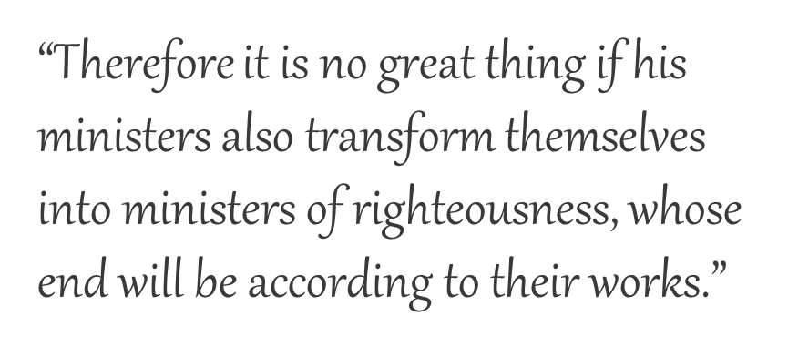
If I Were
SATAN’S MINISTER
2 Corinthians 11:15
(part 2)

Slide 3

Marks of Satan’s Minister
Acts 13:6-10
Calls himself what he is not
Turns away from the faith
Full of deceit & fraud
Enemy of righteousness
Perverts the straight ways

Slide 4

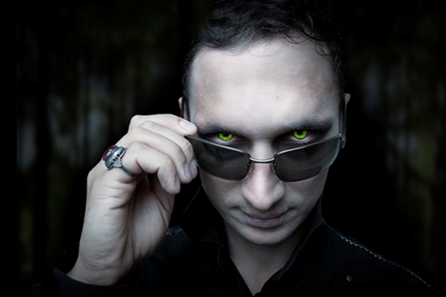
If I were Satan’s Minister…
“God would never be angry with you as long as you are sincere.”
I would teach that only sincerity matters.

Slide 5
Joshua 24:14, “Now therefore, fear the LORD, serve Him in sincerity and in truth, and put away the gods which your fathers served on the other side of the River and in Egypt. Serve the LORD!”
1 Corinthians 5:8, “Therefore let us keep the feast, not with old leaven, nor with the leaven of malice and wickedness, but with the unleavened bread of sincerity and truth.”

Slide 6


SINCERITY,
Nothing Else Matters!
doctor – wrong surgery
“But I sincerely thought…”

Slide 7
SINCERITY,
Nothing Else Matters!
doctor – wrong surgery
football receiver – runs to wrong goal
pharmacist – wrong prescription
nurse – wrong shot
pilot – wrong city
cook – wrong mush-room (poisoned)
hunter – shoots the wrong target (human)
preacher – preaches the wrong gospel
  Gal 1:8, 9????
IT IS OKAY
IF SINCERE?

Slide 8
SINCERITY,
Nothing Else Matters!
Was Cain insincere or did he do something wrong?
  Genesis 4:3-7?
Why did Abimelech nearly die?
  Genesis 20:1-7?

Slide 9
Does Sincerity Makes All Things Pure?
“Therefore you shall be careful to do as the LORD your God has commanded you; you shall not turn aside to the right hand or to the left” (Deut. 5:32)?
Why did Jesus say, “Not everyone who says to Me, ‘Lord, Lord,’ shall enter the kingdom of heaven, but he who does the will of My Father in heaven”?
  Matthew 7:21

Slide 10
What about a sincere atheist?
  Hebrews 11:6, “But without faith it is impossible to please Him, for he who comes to God must believe that He is, and that He is a rewarder of those who diligently seek Him.”
What about a sincere Jew?
  “He who believes in Him is not condemned; but he who does not believe is condemned already, because he has not believed in the name of the only begotten Son of God” (Jn. 3:18)

Slide 11

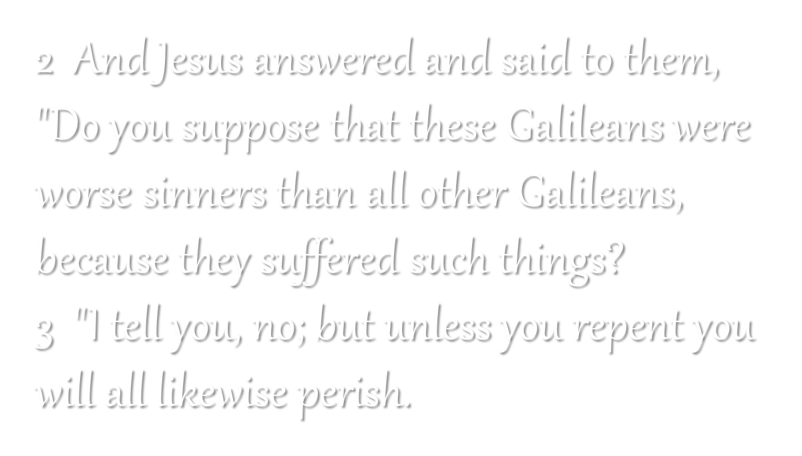
Luke 13:2, 3

Slide 12
If I were Satan’s Minister…
“Worship the way you want.”
I would teach that all worship is acceptable to God. There are no hard rules. Do not be a legalist!

Slide 13
How Instrumental Music Was Introduced to the Quail Springs church of Christ
For years treat as a nonissue
Express desire to look to modernize worship a year before
Announce the elders’ decision to move toward a contemporary service

Slide 14
How Instrumental Music Was Introduced to the Quail Springs church of Christ
Have a Sat. night instrumental activity and call it “worship”
Use it to justify mechanical instruments in worship for Sunday
Have preacher prepare congregation with sermons beforehand

Slide 15
“Judge With Righteous Judgment.”
John 7:24
Son of God:
“But the hour is coming, and now is, when the true worshipers will worship the Father in spirit and truth; for the Father is seeking such to worship Him”
(Jn. 4:23)
Satan’s Minister:
“We don't make any judgments about any other congregations about what they should or shouldn't do.”
--Mark Henderson
(http://www.network54.com/Forum/150389/thread/1202116157/1/Quail+Springs+Church+Adopts+Instruments+for+Worship)

Slide 16

“God is Spirit, and those who worship Him must worship in spirit and truth”
(Jn. 4:24)
“speaking to one another in psalms and hymns and spiritual songs, singing and making melody in your heart to the Lord” (Eph. 5:19)

Slide 17

Worship How You Please?
Cain’s offering rejected?
  Gen. 4:3-7
Moses’ nephews consumed by fire with their kind of worship?
  Lev. 10:1-3
Sacred assemblies despised?
“I hate, I despise your feast days, And I do not savor your sacred assemblies”
  Amos 5:21

Slide 18
“Keep back Your servant also from presumptuous sins; Let them not have dominion over me. Then I shall be blameless, And I shall be innocent of great transgression” (Psa. 19:13)

